Slide 1
COMM 313 FINAL PROJECT
Raven Sulaimon

Slide 2
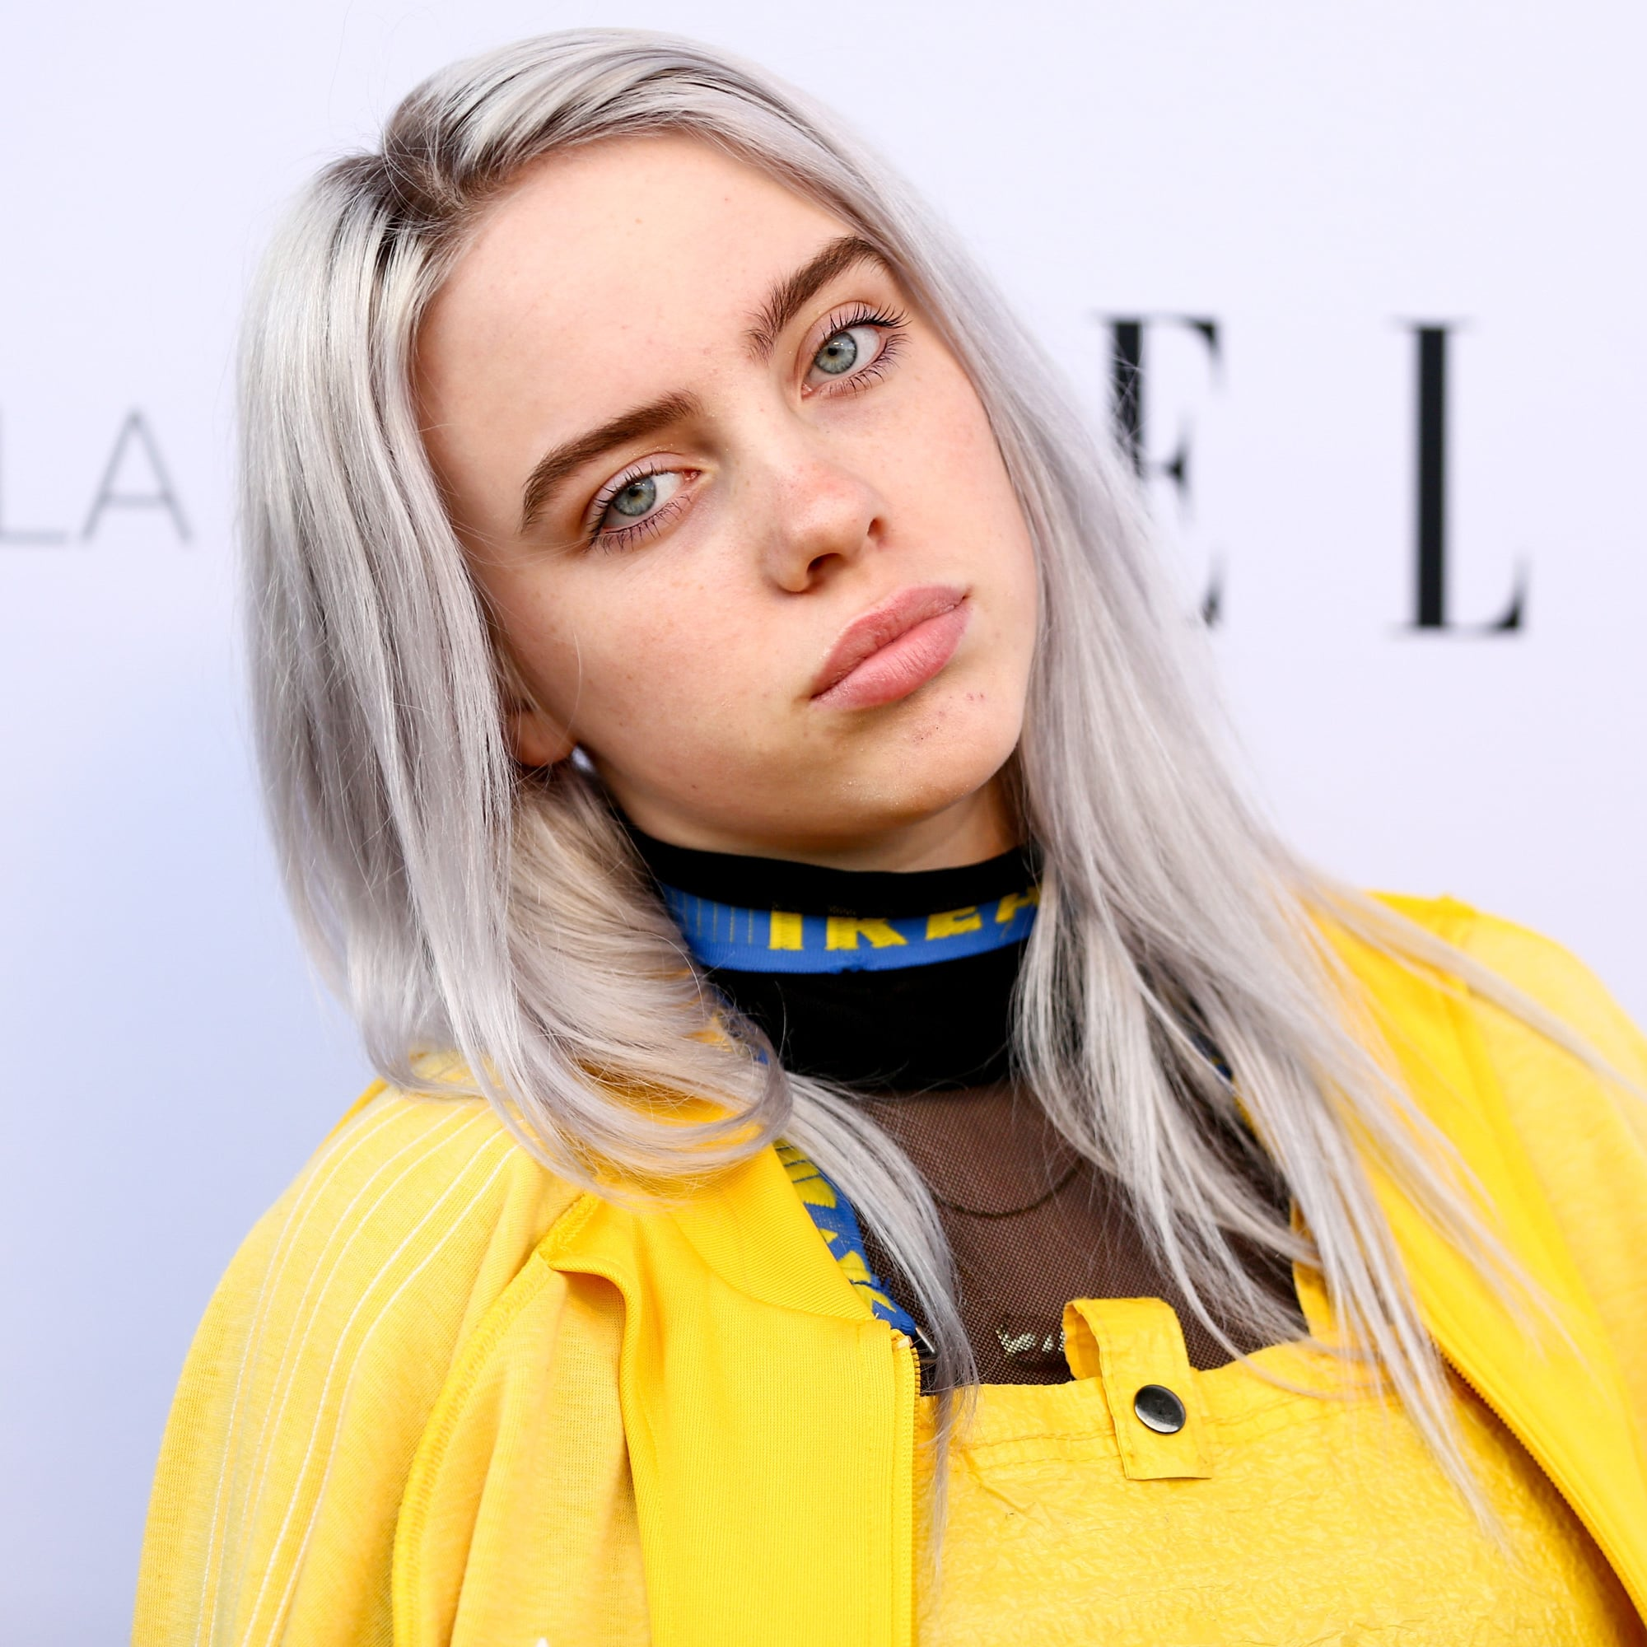
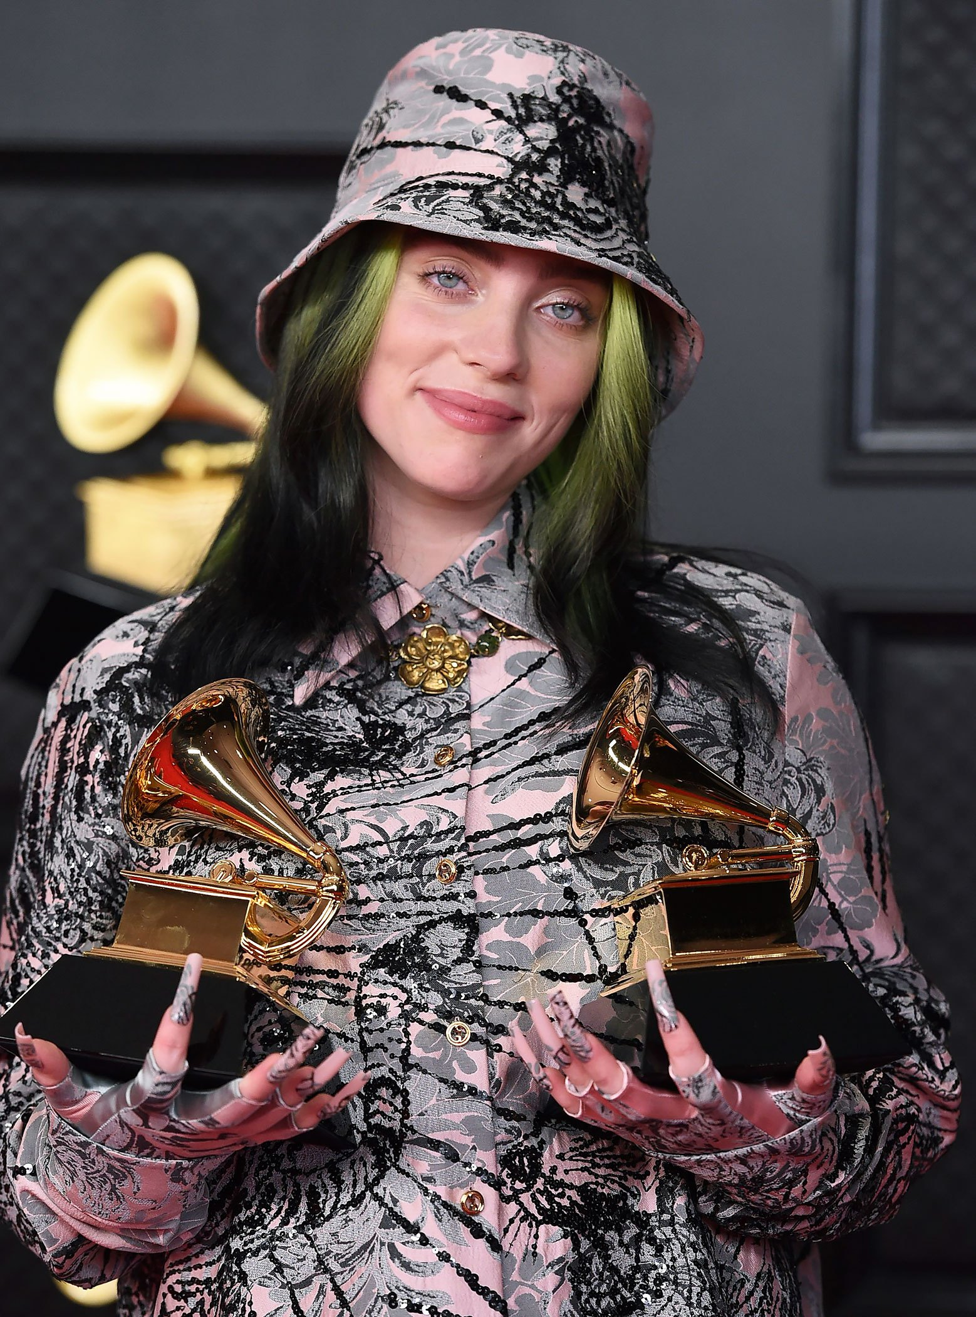
Research Question
Hypothesis
How has Billie Eilish’s music linguistically changed from 2016 – 2021?
Billie Eilish’s music has gotten more abstract over the course of 5 years, and she uses more symbolism in her songs compared to her distinct lyrics from earlier years.

Slide 3
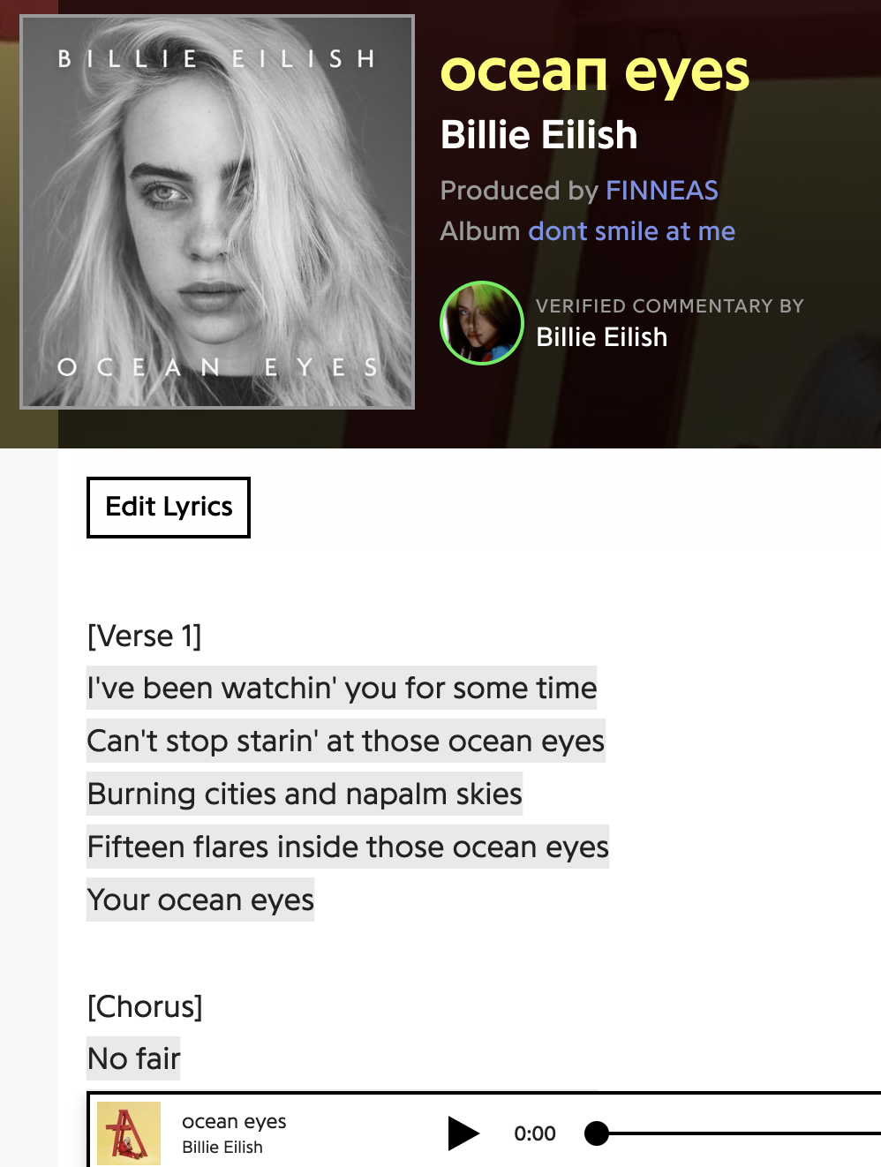
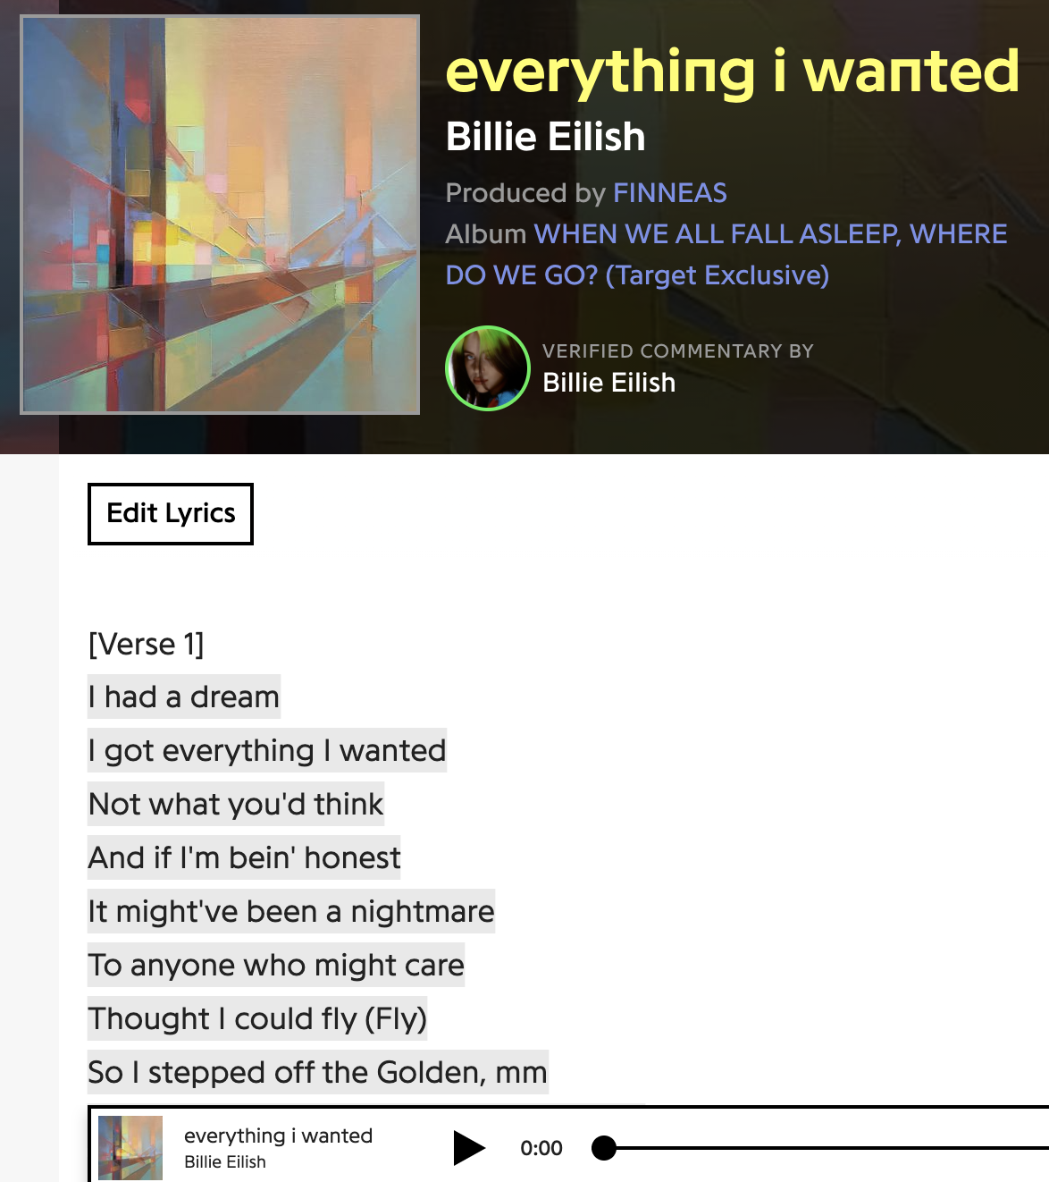
Data
Corpus gathered from Genius API
26 Billie Eilish singles over the course of 5 years (2016-2021)

Slide 4
Analysis
Results
Word and phrase frequency analysis
Concordance analysis
Sentiment analysis
So far, my data has shown that Billie does not use the same words frequently, but she uses the same themes from year to year.

Slide 5
Next Step Plans
Working on the sentiment analysis to further understand the themes/emotions in each of her singles
Additionally, seeing which themes are most frequent each year as well as across all years

